Slide 1
UNIT 9: Live Session
Introduction to Linear Regression

Slide 2
Example :
Studying Hours and Grades!

Slide 3
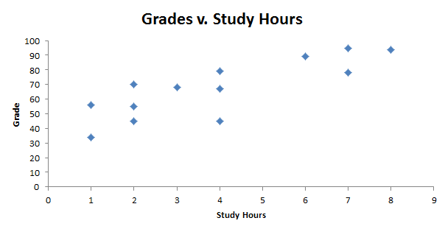
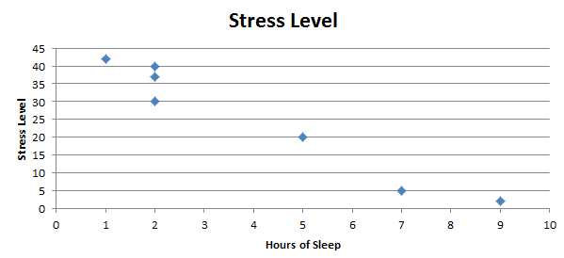
Grades v. Study Hours
A
B

Slide 4
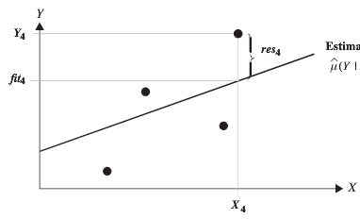
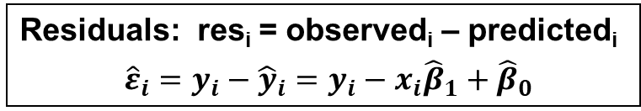
The "Best" Line is the Regression Line
Residuals: res_{i} = observed_{i} – predicted_{i}
${\hat{ε}}_{i}=y_{i}−{\hat{y}}_{i}={y_{i}−x}_{i}{\hat{β}}_{1}+{\hat{β}}_{0}$
The regression line minimizes the sum of vertical distances from the points to the line.
Considering the absolute value of distances is not a good approach because the sum of the absolute values is not differentiable, making the minimization process very difficult. Also, there can be more than one line that minimizes the sum of absolute values. So we consider the sum of squared residuals.
res₄ = 4
res₂ = 1
res₃ = -2
res₁ = -3
Sum of Squared Residuals = SSR =

Slide 5
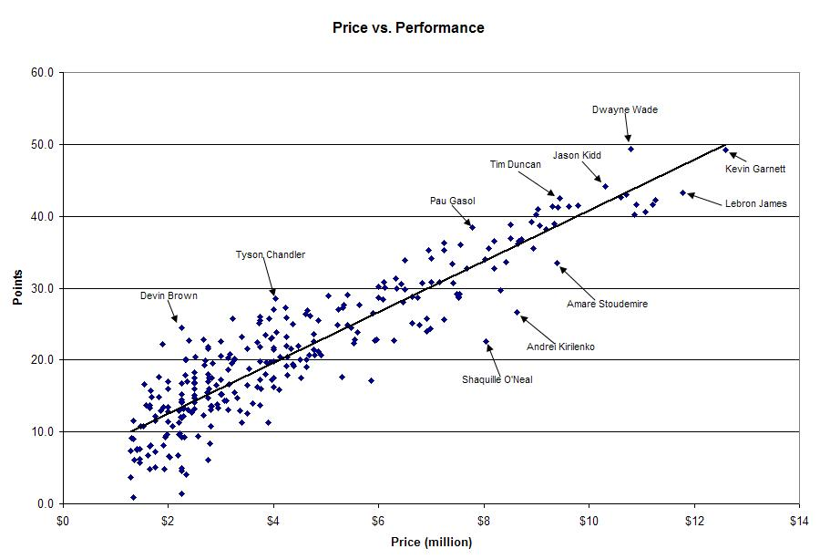

Basketball Players: Salary vs. Measure of Points Production
$\hat{Points}$ = 6 + 3(Price)
r² = 0. 823
What is the best predicted max points in a single game for a player who is paid $9.5 million?
Predicted Max Points = 6 + 3 * 9.5 = 34.5 points!

Slide 6

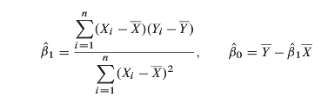
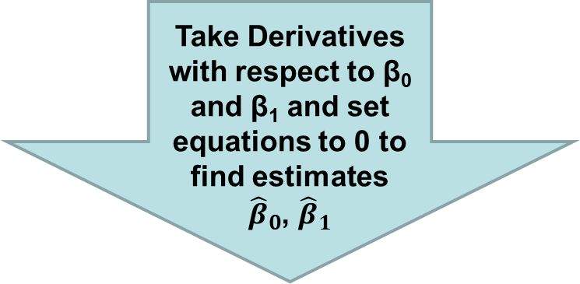
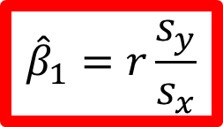
How to Estimate Regression Coefficients
Take Derivatives with respect to β₀ and β₁ and set equations to 0 to find estimates
${\hat{β}}_{0}$, ${\hat{β}}_{1}$
$${\hat{β}}_{1}=r\frac{s_{y}}{s_{x}}$$
=>

Slide 7
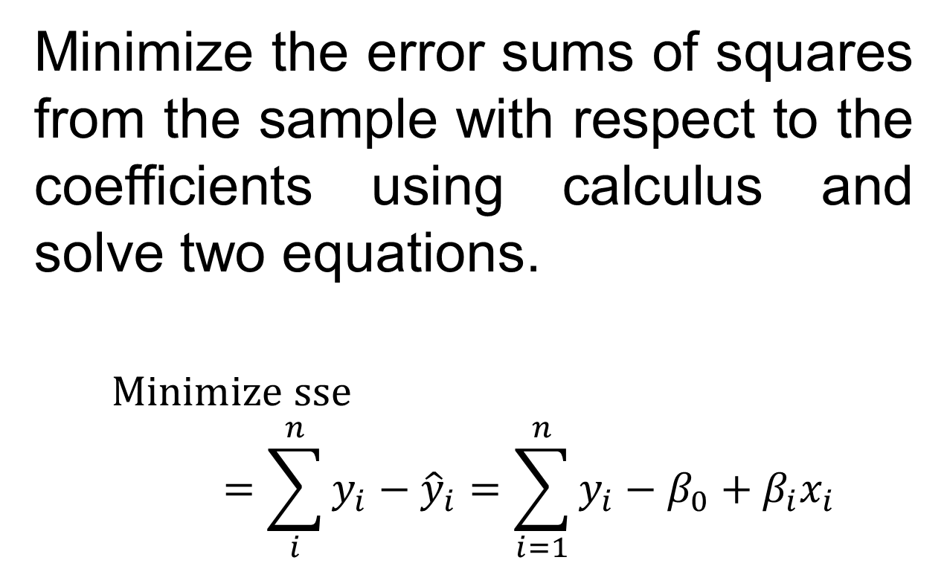
Derive the Intercept and Slope Coefficients in Regression Minimize the error sums of squares
Minimize the error sums of squares from the sample with respect to the coefficients using calculus and solve two equations.
$$Minimize sse=\sum_{i}^{n}{y_{i}−{\hat{y}}_{i}=\sum_{i=1}^{n}{y_{i}}}−β_{0}+β_{i}x_{i}$$

Slide 8
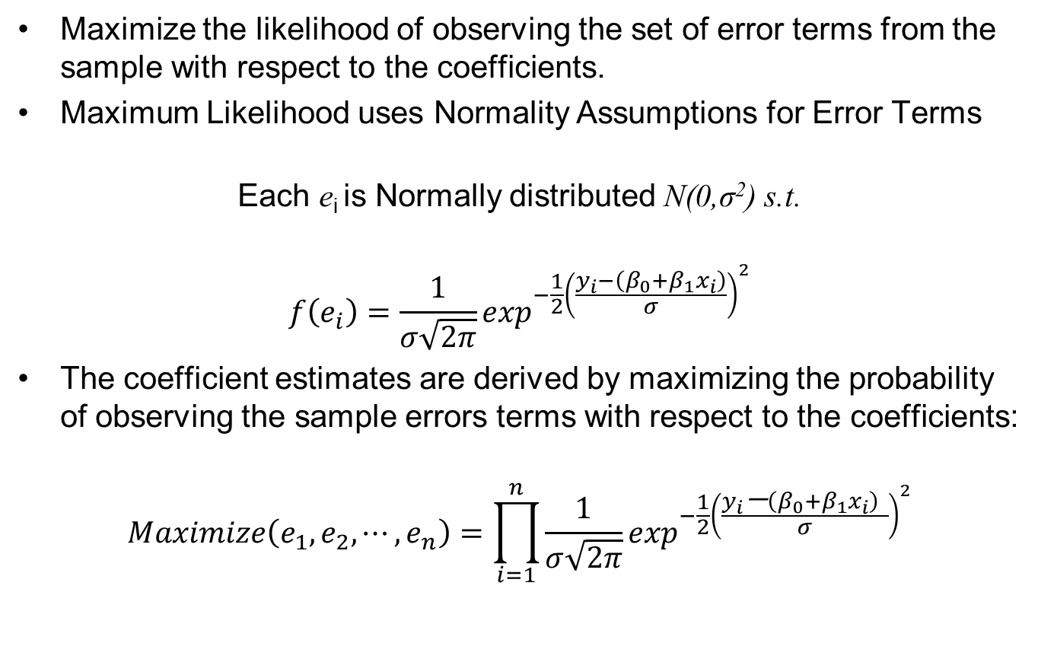
Derive the Intercept and Slope Coefficients in Regression Maximum Likelihood
Maximize the likelihood of observing the set of error terms from the sample with respect to the coefficients.
Maximum Likelihood uses Normality Assumptions for Error Terms
Each e_{i} is Normally distributed N(0,σ²) s.t.
$$f\left(e_{i}\right)=\frac{1}{σ\sqrt{2π}}\exp^{−\frac{1}{2}{\left(\frac{y_{i}−\left(β_{0}+β_{1}x_{i}\right)}{σ}\right)}^{2}}$$
The coefficient estimates are derived by maximizing the probability of observing the sample errors terms with respect to the coefficients:
$$Maximize\left(e_{1},e_{2},⋯,e_{n}\right)=\prod_{i=1}^{n}{\frac{1}{σ\sqrt{2π}}\exp^{−\frac{1}{2}{\left(\frac{y_{i}\text{−}\left(β_{0}+β_{1}x_{i}\right) }{σ}\right)}^{2}}}$$

Slide 9
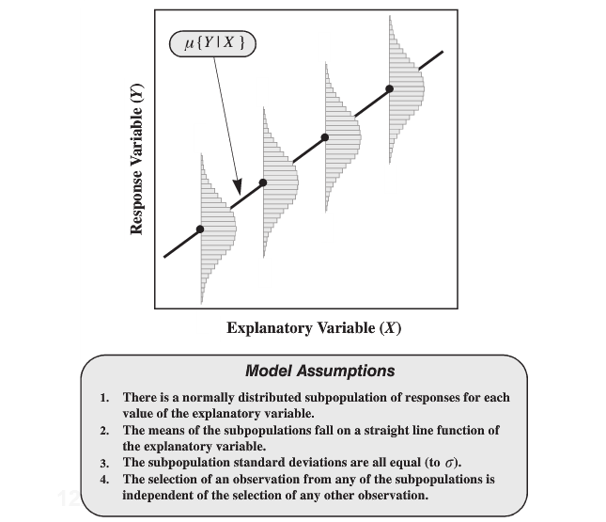
Regression Model: Assumptions

Slide 10
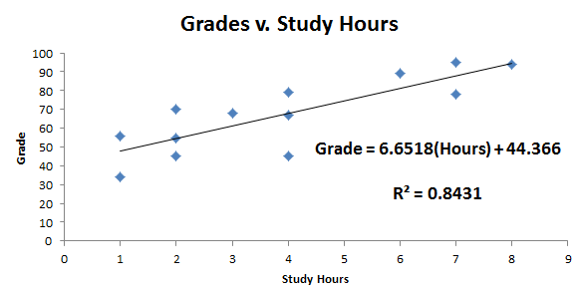
Interpret the slope:Grades v. Study Hours
Interpret the slope
Each extra hour spent studying results in a 6.6518 point increase in the predicted grade.
Interpret the y – intercept
The predicted grade for a student who studies no hours is 44.37 points.
(Careful Here – Do we have an observation with no study hours)

Slide 11
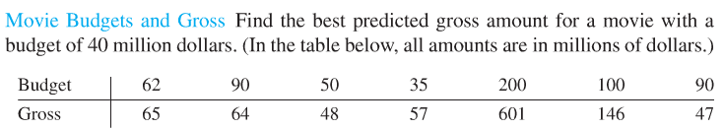
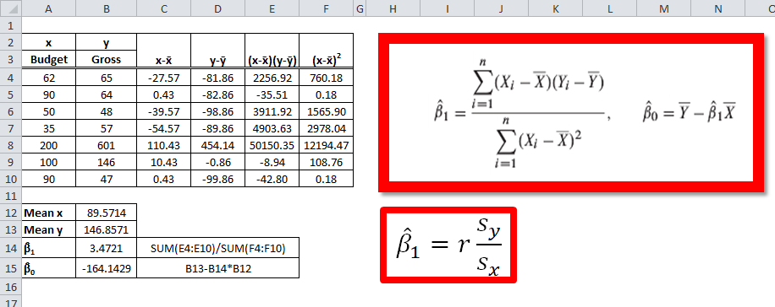
Movies Example: Regression Equation Calculations

Slide 12
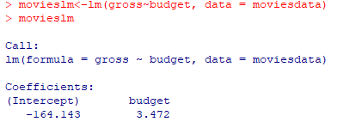
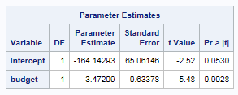
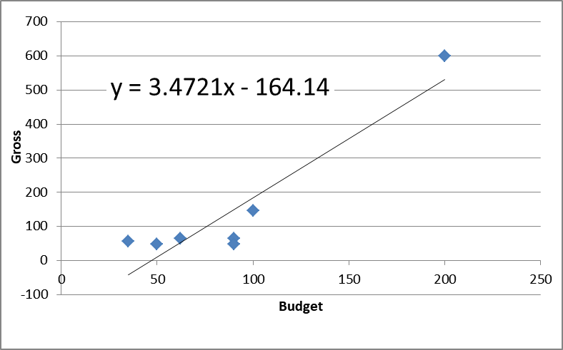
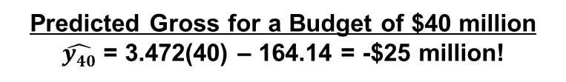
Movies Example: Regression Equation & Predicted Value of y|x
R Code and Output
SAS Code and Output
proc reg data= movie;
model gross = budget;
run;
proc glm data = movie;
model gross = budget;
run;
OR
Equation of Regression Line
Predicted Gross = 3.472 * Budget – 164.14
What's the Problem Here?
Predicted Gross for a Budget of $40 million
$\hat{y40}$ = 3.472(40) – 164.14 = -$25 million!

Slide 13
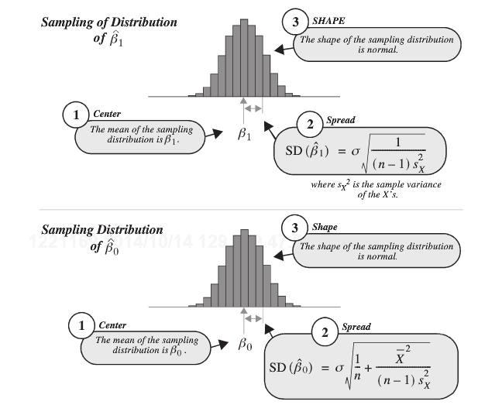

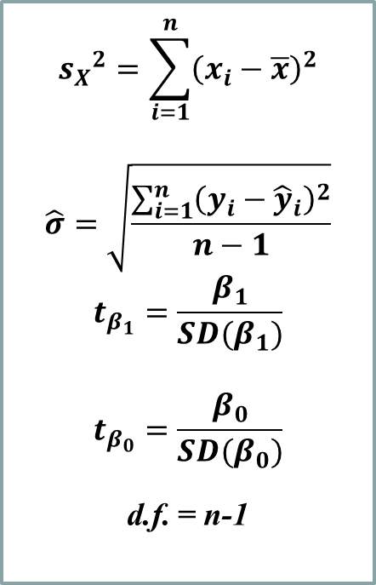
Sampling Distributions for Hypothesis Tests for β₀ and β₁
$${s_{X}}^{2}=\sum_{i=1}^{n}{{\left(x_{i}−\overline{x}\right)}^{2}}$$
$$\hat{σ}=\sqrt{\frac{\sum_{i=1}^{n}{{\left(y_{i}−{\hat{y}}_{i}\right)}^{2}}}{n−1}}$$
$$t_{β_{1}}=\frac{β_{1}}{SD(β_{1})}$$
$$t_{β_{0}}=\frac{β_{0}}{SD(β_{0})}$$
d.f. = n-1

Slide 14
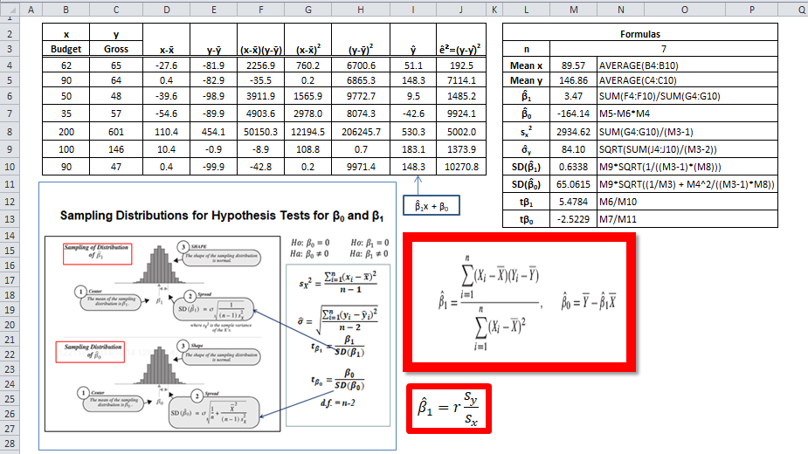
Significance Tests for Regression Coefficient Estimates
See Display 7.7 in Text p. 185

Slide 15
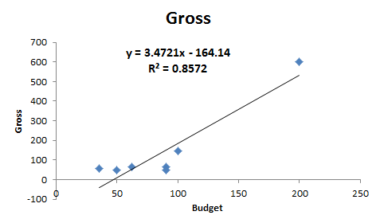
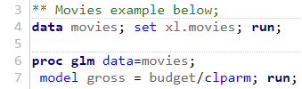

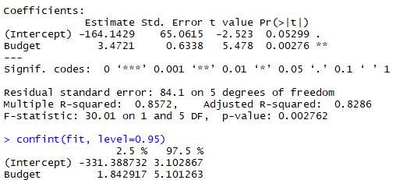

Example Movies: Regression Code and Output
SAS Code and Output
R Code and Output

Slide 16
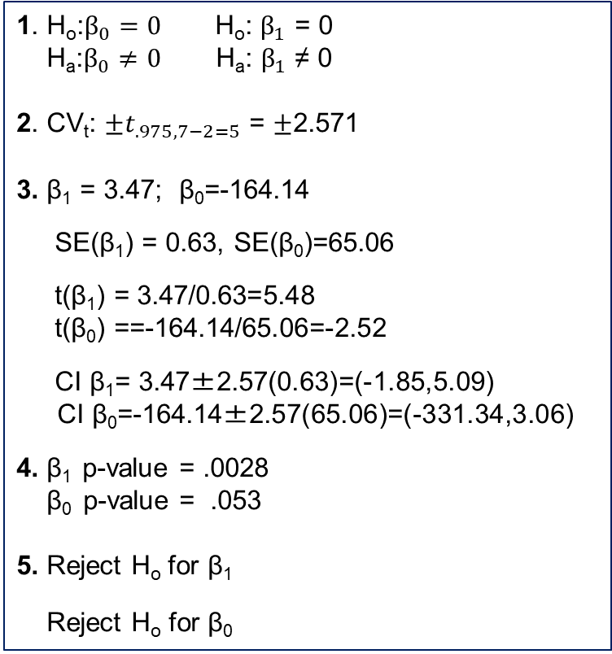
Movies: Hypothesis Tests & Confidence Interval for $β_{1}$, $β_{0}$
Equation of Regression Line
Gross Estimate = -164.14 + 3.47(Budget)
t-stat = (β_{k}– 0)/SE(β_{k})
CI(β_{k}) = β_{k} + CV_{t}SE(β_{k})
1. H_{o}:$β_{0}=0$ H_{o}: $β_{1}$ = 0
H_{a}:$β_{0}≠0$ H_{a}: $β_{1}$ ≠ 0
2. CV_{t}: $±t_{.975, 7−2=5}$ = $±$2.571
3. β₁ = 3.47; β₀=-164.14
SE(β₁) = 0.63, SE(β₀)=65.06
t(β₁) = 3.47/0.63=5.48
t(β₀) ==-164.14/65.06=-2.52
CI β₁= 3.47±2.57(0.63)=(-1.85,5.09)
CI β₀=-164.14±2.57(65.06)=(-331.34,3.06)
4. β₁ p-value = .0028
β₀ p-value = .053
5. Reject H_{o} for β₁
Reject H_{o} for β₀
6. There is sufficient evidence at the alpha = .05 level of significance (p-value = .0028) to suggest that the data are linearly correlated (or that the slope is nonzero). There is not sufficient evidence to suggest the intercept is not zero for the regression line. Consider collecting more data or eliminating outliers.

Slide 17
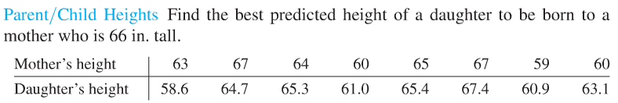
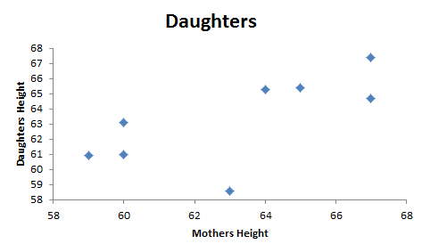
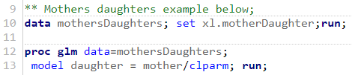

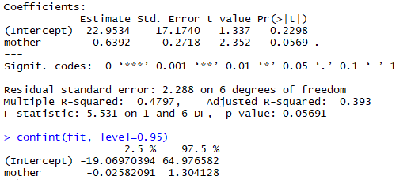

Example Mother/Daughter: Regression Code and Output
SAS Code and Output
R Code and Output

Slide 18

Mother/Daughter: Hypothesis Tests & CI for $β_{1}$, $β_{0}$
Equation of Regression Line
DaughterH = 22.95 + 0.64(MotherH)
t-stat = (β_{k}– 0)/SE(β_{k})
CI(β_{k}) = β_{k} + CV_{t}SE(β_{k})
1. H_{o}:$β_{0}=0$ H_{o}: $β_{1}$ = 0
H_{a}:$β_{0}≠0$ H_{a}: $β_{1}$ ≠ 0
2. CV_{t}: $±t_{.975, 8−2=6}$ = $±$2.45
3. β₁ = 0.64; β₀=22.95
SE(β₁) = 0.27, SE(β₀)=17.17
t(β₁) = 0.64/0.27=2.35
t(β₀) =22.95/17.17=1.34
CI β₁= 0.64±2.45(0.27)=(-0.26,1.30)
CI β₀=22.95±2.45(17.17)=(-19.07,64.98)
4. β₁ p-value = .0589
β₀ p-value = .2293
5. Do not Reject H_{o} for β₁
Do not Reject H_{o} for β₀
6. There is not sufficient evidence at the alpha = .05 level of significance (p-value = .0589) to suggest that the data are linearly correlated (or that the slope is nonzero). There is not sufficient evidence to suggest the intercept is not zero for the regression line. Consider collecting more data or eliminating outliers.

Slide 19
Exercise 1: Crickets
x
y
Manually calculate the slope and intercept of the regression line.
Using the results from question 1, manually calculate the t statistic for the slope and discuss the implications for the test.
Plot the data in comment on whether regression analysis looks like a useful approach to understanding the relationship between chirps and temperature.
Run an analysis using SAS or R showing all t statistics and confidence intervals.
Comment on the program output using the 6 step approach shown in the live session slides. Manually calculate t-statistics and confidence intervals.
Find a prediction for temperature when the chirp rate is 1000/minute. Make sure you convert from logs here.
Manually calculate the slope and intercept of the regression line.
Using the results from question 1, manually calculate the t statistic for the slope and discuss the implications for the test.
Plot the data in comment on whether regression analysis looks like a useful approach to understanding the relationship between chirps and temperature.
Run an analysis using SAS or R showing all t statistics and confidence intervals.
Comment on the program output using the 6 step approach shown in the live session slides. Manually calculate t-statistics and confidence intervals.
Find a prediction for temperature when the chirp rate is 1000/minute.

Slide 20
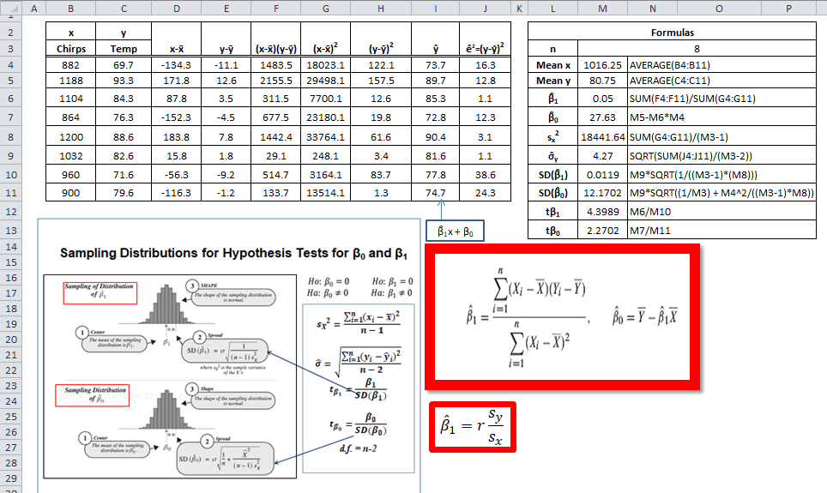
Solution Exercise 1: Crickets Manual Calculations

Slide 21
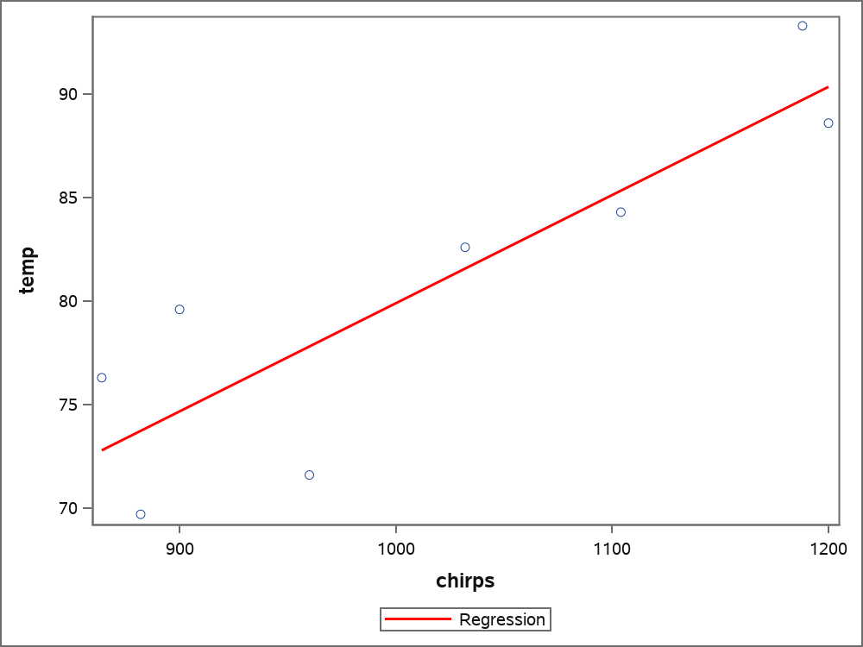
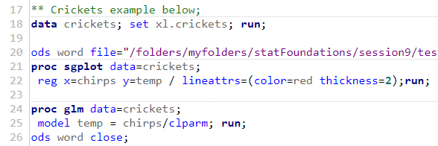
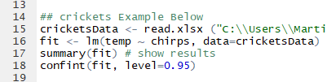
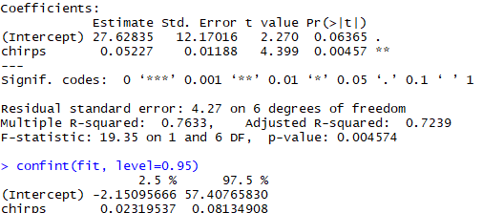

Solution Exercise 1: Crickets SAS and R Code and Output
SAS Code and Output
R Code and Output

Slide 22
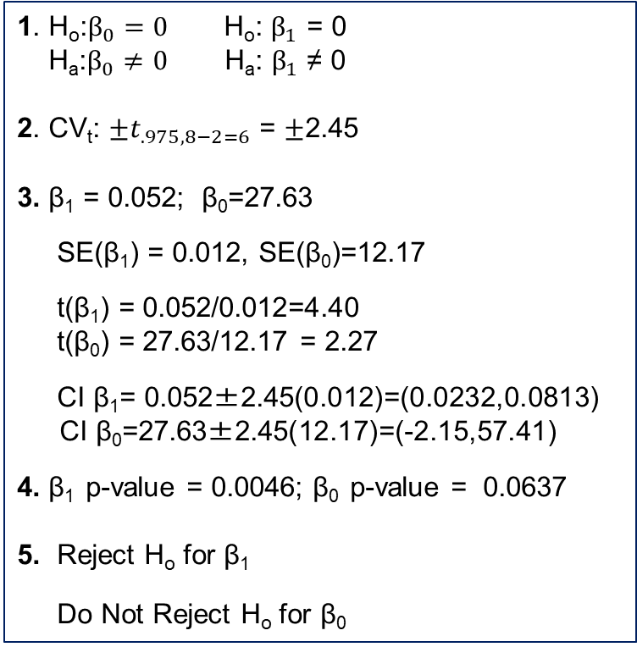
Exercise 1: Crickets: Hypothesis Tests & CI for $β_{1}$, $β_{0}$
Equation of Regression Line
Chirps = 5.77 + 0.014(Temp)
t-stat = (β_{k}– 0)/SE(β_{k})
CI(β_{k}) = β_{k} + CV_{t}SE(β_{k})
1. H_{o}:$β_{0}=0$ H_{o}: $β_{1}$ = 0
H_{a}:$β_{0}≠0$ H_{a}: $β_{1}$ ≠ 0
2. CV_{t}: $±t_{.975, 8−2=6}$ = $±$2.45
3. β₁ = 0.052; β₀=27.63
SE(β₁) = 0.012, SE(β₀)=12.17
t(β₁) = 0.052/0.012=4.40
t(β₀) = 27.63/12.17 = 2.27
CI β₁= 0.052±2.45(0.012)=(0.0232,0.0813)
CI β₀=27.63±2.45(12.17)=(-2.15,57.41)
4. β₁ p-value = 0.0046; β₀ p-value = 0.0637
5. Reject H_{o} for β₁
Do Not Reject H_{o} for β₀
6. There is sufficient evidence at the alpha = .05 level of significance (p-value = 0.0046) to suggest that the data are linearly correlated (or that the slope is nonzero). There is not sufficient evidence to suggest the intercept is not zero for the regression line. Get more data or go with it for prediction.
Temperature prediction when chirps = 1000/min
0.052*1000 + 27.63 = 79.63

Slide 23
Exercise 2: Marathons
Plot the data in comment on whether regression analysis looks like a useful approach to understanding the relationship between chirps and temperature.
Run an analysis using SAS or R showing all t statistics and confidence intervals.
Comment on the program output using the 6 step approach shown in the live session slides.
Should you use the model for prediction? Are there possible reasons, other than what the data suggest, about the usefulness of this model?

Slide 24
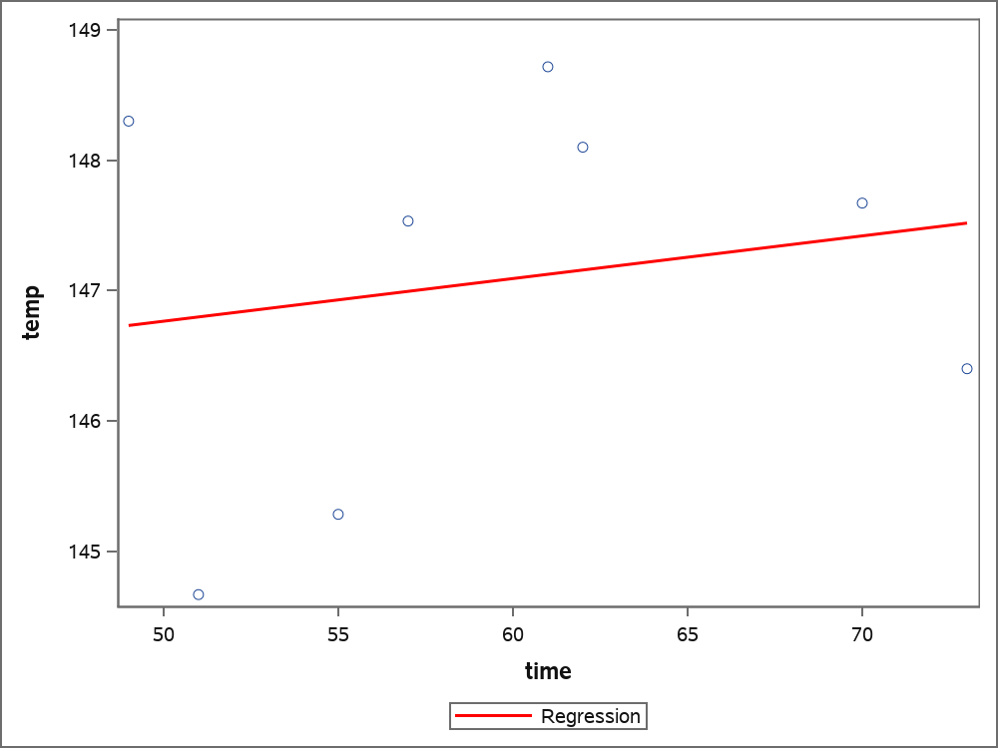
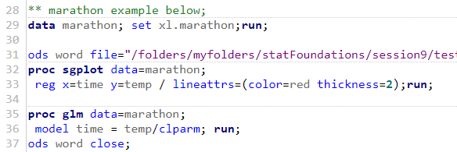

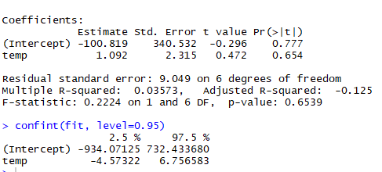

Solution Exercise 2: Marathons SAS and R Code and Output
SAS Code and Output
R Code and Output

Slide 25

Exercise 1: Marathons: Hypothesis Tests & CI for $β_{1}$, $β_{0}$
Equation of Regression Line
Time = -100.81 + 1.09(Temp)
t-stat = (β_{k}– 0)/SE(β_{k})
CI(β_{k}) = β_{k} + CV_{t}SE(β_{k})
1. H_{o}:$β_{0}=0$ H_{o}: $β_{1}$ = 0
H_{a}:$β_{0}≠0$ H_{a}: $β_{1}$ ≠ 0
2. CV_{t}: $±t_{.975, 8−2=6}$ = $±$2.45
3. β₁ = 1.09; β₀=-100.82
SE(β₁) = 2.32, SE(β₀)=340.53
t(β₁) = 1.09/2.32=0.47
t(β₀) = -100.82/340.53 = 0.30
CI β₁= 1.09 ±2.45(2.32)=(-4.57,6.76)
CI β₀=-100.82±2.45(340.53)=(-934.1,732.4)
4. β₁ p-value = 0.7772; β₀ p-value = 0.6539
5. Reject H_{o} for β₁
Reject H_{o} for β₀
6. There is not sufficient evidence at the alpha = .05 level of significance (p-value = 0.7772) to suggest that the data are linearly correlated (or that the slope is nonzero). There is not sufficient evidence to suggest the intercept is not zero for the regression line. This looks like a bad model. There are probably other factors affecting marathon time.
Useful Model?
This is not a good model because the slope coefficient is not significant. Other things that affect marathon time are the course difficulty, time of year, other weather conditions..

